Slide 1


JAVA EE
(AdvAnce JAVA)
Lecture-3

Slide 2
Today’s Agenda
JDBC Packages.
Steps Required In JDBC Programming.

Slide 3
QUIZ
Q1. What is JDBC?
A - JDBC is a java based protocol.
B - JDBC is a standard Java API for database-independent connectivity between the Java programming language and a wide range of databases.
C - JDBC is a specification to tell how to connect to a database.
D - Joint Driver for Basic Connection
Answer: B

Slide 4
QUIZ
Q2. Which of the following manages a list of database drivers in JDBC?
A - DriverManager
B - JDBC driver
C - Connection
D - Statement
Answer: A

Slide 5
QUIZ
Q3. SUN has provided how many drivers for connecting to the database?
A. 1
B. 2
C. 3
D. 4
Answer: A

Slide 6
QUIZ
Q4. How many type of drivers are there for connecting to the database?
A. 1
B. 2
C. 3
D. 4
Answer: D

Slide 7
QUIZ
Q5. Which of the following type of JDBC driver, is also called Type 1 JDBC driver?
A - JDBC-ODBC Bridge plus ODBC driver
B - Partly Java driver
C - Network driver
D - Native-protocol, pure Java driver
Answer: A

Slide 8
QUIZ
Q6. Which of the following type of JDBC driver, communicates with the database in native protocol?
A - JDBC-ODBC Bridge plus ODBC driver
B - Partly Java driver
C - Network driver
D - Native-protocol, pure Java driver
Answer: D

Slide 9
QUIZ
Q7. Which type of driver provides JDBC access via one or more ODBC drivers?
A - Type 1 driver
B - Type 2 driver
C - Type 3 driver
D - Type 4 driver
Answer: A

Slide 10
QUIZ
Q8. What is the disadvantage of Type-4 Native-Protocol Driver?
A- We require a separate driver for each database.
B- Type-4 driver is entirely written in Java
C- The driver converts JDBC calls into vendor-specific database protocol
D- It does not support to read MySQL data.
Answer: A

Slide 11
JDBC Packages
The JDBC API is comprised of two packages:
java.sql
javax.sql

Slide 12
The java.sql Package
The java.sql package contains the entire JDBC API that sends SQL (Structured Query Language) statements to relational databases and retrieves the results of executing those SQL statements.
The JDBC 1.0 API became part of the core Java API in Java 1.1.

Slide 13
The javax.sql package
The javax.sql package contains the JDBC Extension API.
The classes and interfaces in this package provide new functionality, such as
Connection pooling
Support for disconnected architecture

Slide 14
Steps Of Connectivity
There are 7 steps to connect any java application with the database in java using JDBC. They are as follows:
Import the required packages
Load and Register the driver class
Obtain the connection
Obtain the statement
Executing queries
Process the result
Close the connection

Slide 15
Step 1
As previously mentioned , the JDBC API requires the support of java.sql or javax.sql package.
Thus as the first step we need to import one or both of these packages as per requirement

Slide 16
Step 2
Load and Register the driver
The forName() method of class Class is used to register the driver class. This method is used to dynamically load the driver class.
Syntax:
public static Class forName(String className)throws
ClassNotFoundException
Example:
Class.forName("oracle.jdbc.driver.OracleDriver");

Slide 17
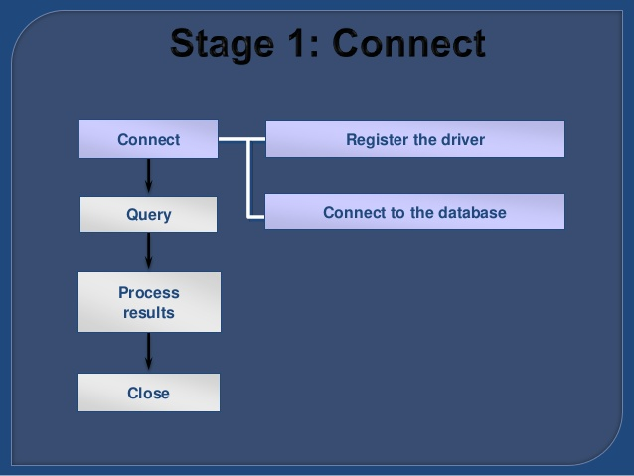
CONNECT

Slide 18
STEP 3
Create the connection object:
The getConnection() method of DriverManager class is used to establish connection with the database.
Syntax:
1) public static Connection getConnection(String url)
throws SQLException
2) public static Connection getConnection (String url,String name,String password) throws SQLException
Example:
Connection con=DriverManager.getConnection(
"jdbc:oracle:thin:@localhost:1521:xe","system","password");

Slide 19
QUIZ
Q1. Which of the following is standard JDBC package ?
A - java.oracle
B - java.sql
C - java.mysql
D -javax.sql
Answer: B

Slide 20
QUIZ
Q2. What do you mean by Connected Architecture ?
A -Connection is open while we are not transferring the data
B -Connection is closed by itself.
C - We do not have to explicitly close the connection
D -None of the above
Answer: A

Slide 21
QUIZ
Q3. Which statement is true about javax.sql package ?
A- It was not a part of standard JDBC 1.0.
B- Concept of connection pooling comes from this package.
C- It support disconnected architecture.
D- All of the above.
Answer: D

Slide 22
QUIZ
Q4.Arrange the following steps properly which is used to connect java application with the database ?
A- Obtain the statement.
B- Import the required package.
C- Obtain the connection.
D- Process the result.
E- Executing queries.
F- Close the connection.
G- Process the result.
H- Load and register the driver class.
Answer:- B,H,C,A,E,G,F

Slide 23
QUIZ
Q5. Which driver is called as thin-driver in JDBC?
A - Type 1 driver
B - Type 2 driver
C - Type 3 driver
D - Type 4 driver
Answer: D

Slide 24
QUIZ
Q6. What do you mean by Connection pooling ?
A- Connection pooling means that connections are reused rather than created each time a connection is requested.
B- Connection pooling means creating new connections on every request and dropping old ones.
C- It is a package.
D- None of the above.
Answer: A

Slide 25
QUIZ
Q7. Which of the following is correct about Class.forName() method call?
A - This method instantiates the driver class object
B - This method dynamically loads the driver's class file into memory, which automatically registers it.
C - Both of the above
D - None of the above.
.
Answer: B

Slide 26
QUIZ
Q8. Which of the following Exception is thrown by Class.forName( ) method
A - NoClassDefFoundError
B - SQLException
C - ClassNotFoundException
D - All of the above.
.
Answer: C

Slide 27
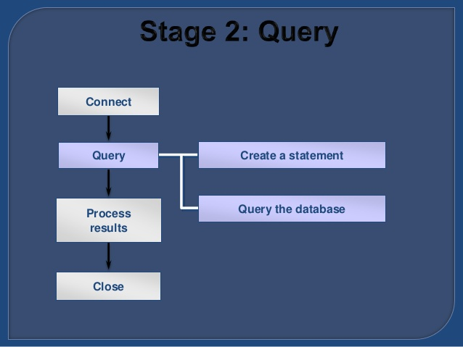
QUERY

Slide 28
STEP4
Create the statement object:
The createStatement() method of Connection interface is used to create statement. The object of statement is responsible to execute queries with the database.
Syntax:
public Statement createStatement()throws
SQLException
Example:
Statement stmt=con.createStatement();

Slide 29
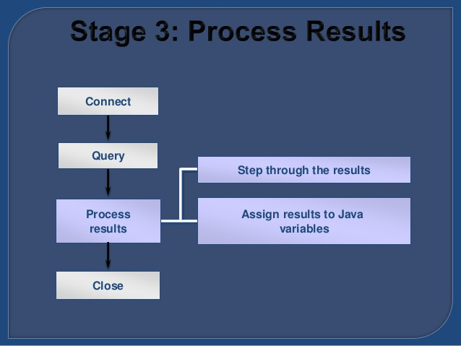
Process Result

Slide 30
STEP 5 & 6
Execute the query:
The executeQuery() method of Statement interface is used to execute queries to the database. This method returns the object of ResultSet that can be used to get all the records of a table.
Syntax:
public ResultSet executeQuery(String sql)throws
SQLException
Example:
ResultSet rs=stmt.executeQuery("select * from emp");
while(rs.next()){
System.out.println(rs.getInt(1)+" "+rs.getString(2));
}

Slide 31
STEP7
Close the connection object:
The close() method of Connection interface is used to close the connection. By closing connection object statement and ResultSet will be closed automatically
Syntax :
public void close()throws SQLException
Example :
con.close();

Slide 32
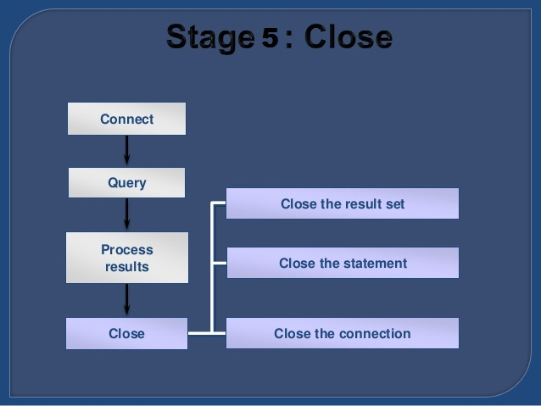
CLOSE

Slide 33

End Of Lecture 3
For any queries mail us @: scalive4u@gmail.com
Call us @ : 0755-4271659, 7879165533
Agenda for Next Lecture:
Executing Non Select Queries
Using PreparedStatement interface

